Slide 1
Components &
Dependency Injection
Advanced Software Engineering 475
Andrew McVeigh

Slide 2
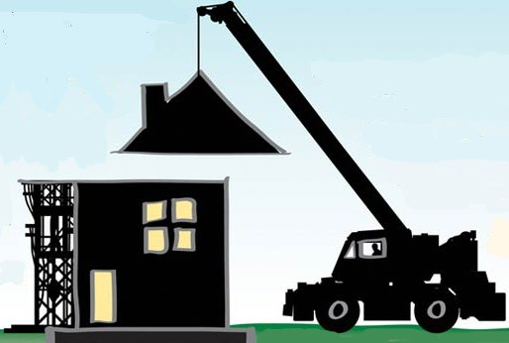
The Dream of Software Components
”Mass Produced Software Components”, 1968
  Address by Doug McIlroy, NATO Software Engineering Conference
  http://www.cs.dartmouth.edu/~doug/components.txt
  Key idea: take prefabricated parts and wire them together
  Have catalogues of components
    Specifications for compatibility and interchangeability
    Choose components based on properties required for system
  An industrial view of software like building construction

Slide 3
What Happened!?
Remains a compelling idea (even after 40 years!)
  *BUT*
Building software in this way proved elusively difficult
(a slight understatement!)
Notes:
Remains a compelling idea (even after 40 years!)
Reuse components between systems
Specifications to guarantee properties and compliance
Component producers can specialise in certain areas
Build systems quickly and cheaply
*BUT*
Building software in this way proved elusively difficult
No real agreement on what a component is!
Lots of different environments components can live in
Too much reliance on external components & vendors
Software is more dynamic than buildings

Slide 4
State of Components in Industry Today...
Some (modest) successes
  COM + Visual Basic components for rapid GUI construction
  JavaBeans for reusable application parts in Java
  Eclipse / Visual Studio for IDE extensibility
  Dependency injection
Some (big) failures
  CORBA distributed objects
  EJB components
In many ways, objects have triumphed over the idea of components
  We'll explore the differences shortly...
Notes:
EJB has been a terrible advertisement for components
Many of the component systems do not follow full component ideas through – e.g. COM has no connectors

Slide 5
Why Then Study Components?
Construction by prefabricated components is a recurring and continuing theme
  Intuitively it seems to make sense
  It works for electronics (and that's a complex domain)
  Concepts keep sneaking back in...
    DI is just components disguised as objects
What we get out of studying components...
  Gives insight into many software trends
  Advantages over objects for many situations (”a better OO”)
    components to complement rather than replace objects
Notes:
What we get out of studying components...
Gives insight into many trends in software
modularity, abstraction, dependency injection, extensibility, architecture, analysis and more...
Advantages over objects for many situations (”a better OO”)
It's not an ”either-or” situation
modern trend is for components to complement rather than replace objects... the techniques can be applied in OO languages.

Slide 6
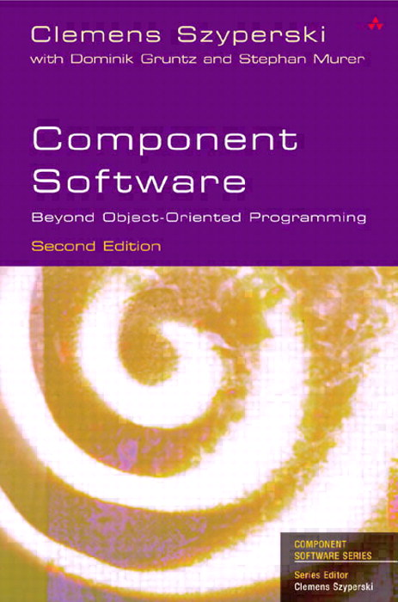
Component Consensus?!
The different perspectives have resulted in many different notions of ”component”
Possibly the most ”popular” definition is from Syperski's Component Software Book
A component:
  Is a unit of independent deployment
  Is a unit of third party composition
  Has no persistent state
Too vague...
Notes:
The 3 component concepts make much more sense when you understand the full component model I'm about to describe.

Slide 7



A Component Depends On Where You Look From...
(and who you ask!)
A component can be...
A unit for analysing a system
A unit of composition and deployment
analysis ► design ► deployment
A unit of design in a system
Notes:
A unit for analysing a system:
Components have nice properties which allow them to be used to analyse a system. i.e. for concurrency, protocols...
A unit of composition and deployment
i.e. snap together your application from big, fat components.
A unit of design in a system:
Units which can be composed and reused within a design.
This forces architecture to be explicit.

Slide 8
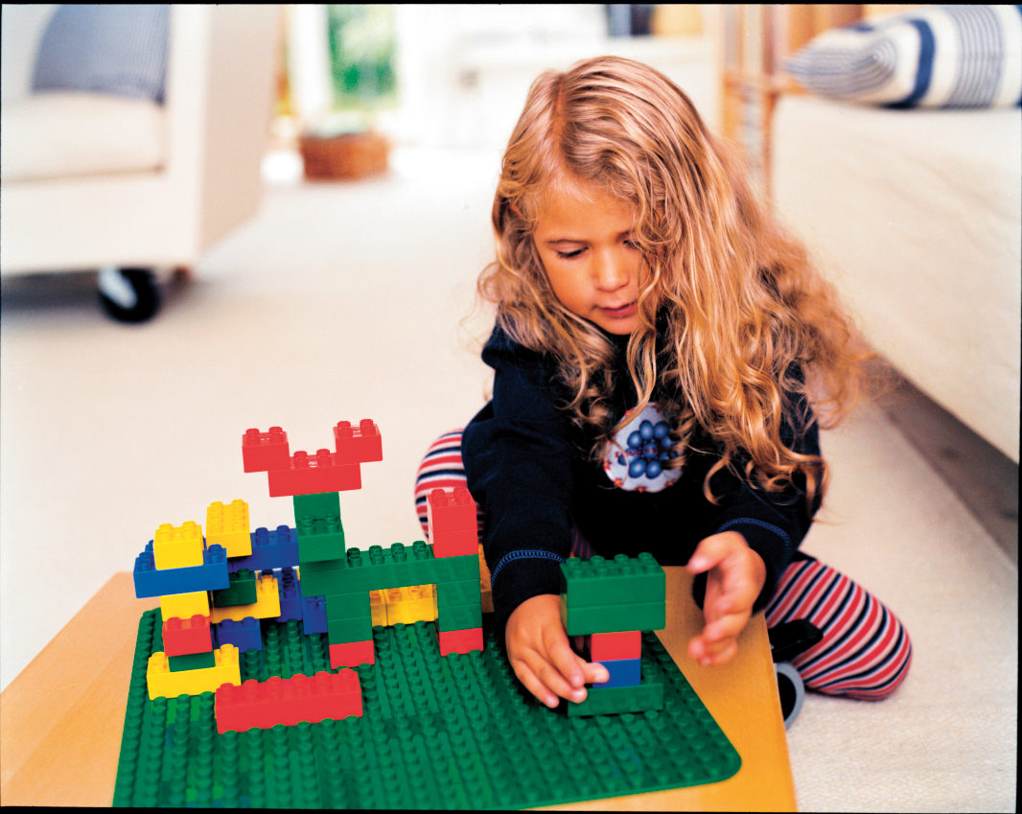
An Intuitive View Of Components

Slide 9
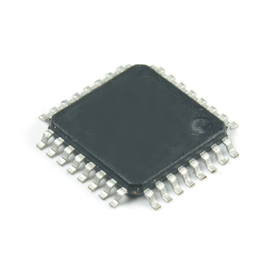
Developing an Intuition for Components
Consider an electronics metaphor
Let's start with a chip...
Each chip is an instance of a design / template
It has interfaces (also called pins)
  Describe what it provides and requires
Interface pins
Chips has a specification
and a design,
we can make more
Notes:
Each chip is an instance of a design / template
It has interfaces (pins) describing its interaction with the rest of the world, and a specification
Substitution, compatibility
Interfaces describe what it provides and requires fully
It is context independent!

Slide 10
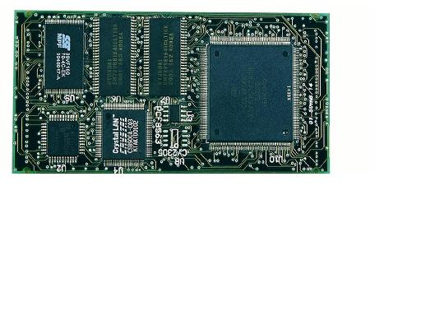
Wiring up a Circuit Board
Wire up some of these chips into a larger circuit – a ”composite” component
Two instances of the same chip
Circuit has a specification,
and a design,
we can make more
Interface pins
Chip that has been wired up
Circuit board and wiring (tracks)

Slide 11
But a circuit board can be shrunk
We can hide the insides and pretend it's a big chip!
Notes:
This happens in electronics all the time
- but it takes a lot of effort and technology
We don't have the same limitations in software
- shrinking is much easier, as it just requires us to ignore the insides and focus on the interfaces / outside

Slide 12
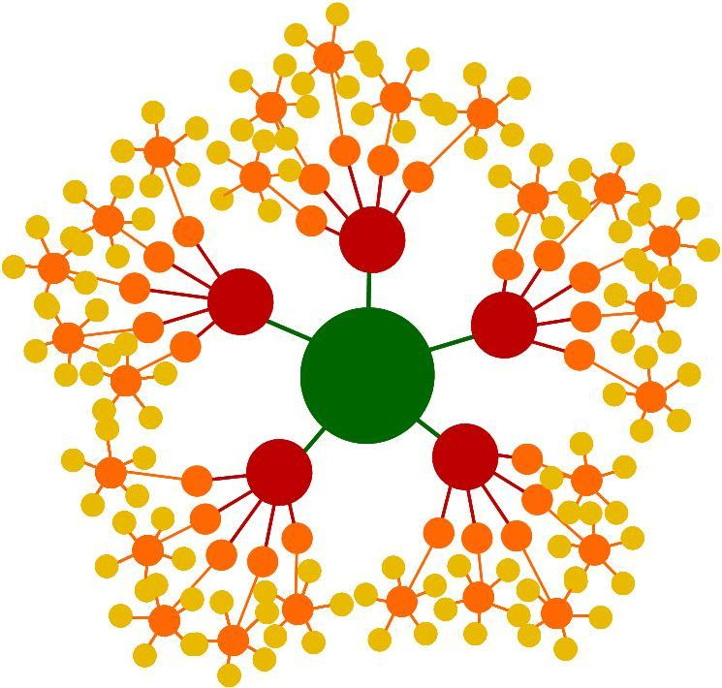
Thinking about Circuits and Chips...
Just imagine if we could magically shrink the (populated) circuit board down to chip size...
  If we could do this, there would be no difference between a circuit board and a chip
  We can effectively build up higher and higher levels of abstraction by building circuit boards with higher level ”chips”
This is a fractal or hierarchical model
  The essential form of a circuit / chip
  is the same from any level of
  abstraction

Slide 13
A Hierarchical Model of Circuits...
Consider that we have a composition hierarchy!
Note that a circuit board has no ”smarts”: it's the chips!
    It is just a wiring up of other chips (or circuit boards)
    We can make an identical circuit by wiring up the leaf chips directly!
wire
circuit board
chip
circuit board
higher abstraction
chip
chip
circuit board
chip
chip
circuit board
chip
chip
chip
chip

Slide 14
So, How Does This Help?
analysis ► design ► deployment
Analysis:
  Communications between internal parts are hidden
Design
  We build circuits by composing other circuit boards and chips
Deployment
  We plugin chips into our circuit boards
  We sell chips and also circuit boards, both populated and not...
Notes:
Analysis:
Each circuit or chip can be analysed at its interfaces: a black box
Communications between internal parts are hidden
The action all happens in the chips at the bottom of the hierarchy
Design
We build circuits by composing other circuit boards and chips
This raises the level of abstraction, giving us more power
The architecture is explicit. We know what connects to what.
We can test each component in isolation (context independence)
Deployment
We plugin chips into our circuit boards
We sell chips and also circuit boards, both populated and not...

Slide 15
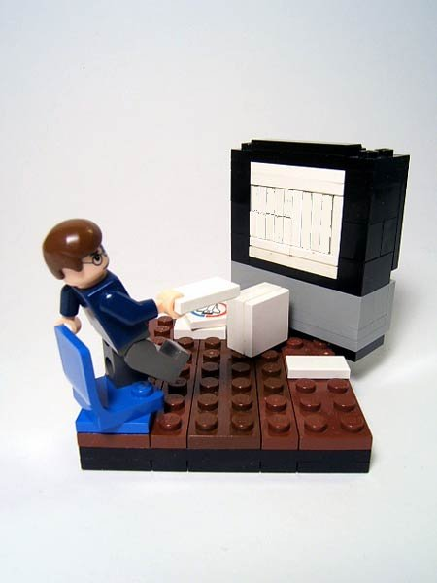
Applying Component Ideas To Software

Slide 16
Software Components
Let's apply these intuitions to software
  We want to be able to create software out of reusable blocks
It's easier in software than circuits...
  i.e. We can automatically ”shrink” a ”circuit” down to a ”chip”
  Instantiating software components is cheaper than making circuits and chips
We get some ”disadvantages” over normal OO
  We need to limit some aspects of software to fit with components
  Are these limitations really disadvantages?!
Notes:
Intuitions
We want to be able to create software out of reusable blocks
We want to have explicit architectures and be able to analyse
Advantages...
i.e. We can automatically ”shrink” a ”circuit” down to a ”chip”
We don't worry about physical effects such as transmission speed
except in distributed systems where this becomes important again...
Instantiating software components is cheaper than instantiating circuits and chips
Disadvantages
Do these limitations actually help?
Does full OO allow us freedom to create bad s/w?

Slide 17
Leaf: A Software ”Chip”
A leaf component is a ”chip design”
  It has interfaces to show what is provided and required
  It can also have properties (attributes) which hold state
  We can instantiate it as many times as required
  It is not decomposed further into smaller parts
public class Leaf
implements Interface
{
public int attribute = 5;
private Interface port2;
public void setPort2(Interface i)
{ port2 = i; }
}

Slide 18
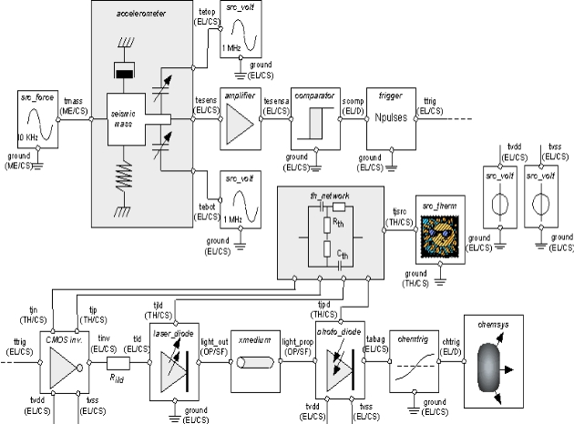
Leaf: A Software ”Chip” (2)
The class is a ”chip design”
Chip design
Software component (class)
public class Leaf
{
...
}
used to create
instances
Chip
Part (instance)
new Leaf();
Notes:
A chip design is like a class
- it can be used to create many copies of the same chip
A chip is like an object / instance
- has its own state when it is running

Slide 19
Composite: A Software Circuit
”wire up chips into a circuit board”
  Connect up component instances into a new component
public class Composite
{
private Leaf a = new Leaf();
private Leaf b = new Leaf();
public Composite()
{ a.setPort2(b.getPort1()); }
public Interface getPortA()
{ return a.getPort1(); }
public void setPortB(Interface i)
{ b.setPort2(i); }
}
Looks simple -
Perhaps we could generate it from pictures?
Notes:
NOTE: no actual logic is needed in the composite class
- it's just wiring instructions
- we don't have the same physical limitations of a circuit board (e.g. Takes ages to route wires)
Since no logic is present – the wiring can be generated from the pictures quite easily

Slide 20
Composite: A Software Circuit (2)
No logic in the composite class
So, we can generate this class from the diagrams
Or we can go one better
  All hierarchies can be flattened
Good things come from composites with no logic...
  Just wiring instructions - like a circuit board
A profound approach
Notes:
No logic in the composite class
Just connections and delegated calls
Can also have attributes, but these are mapped onto leaf attributes
So, we can generate this class from the diagrams
Or we can go one better
Any hierarchy turns into connections between leaf instances, just as any complex circuit board turns into connections between chips
We can instantiate the leaves and connect them up using reflection from the diagram
Good things come from composites with no logic...
No expressive power is lost
They are effectively just wiring instructions, like a circuit board

Slide 21
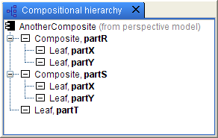
Composites Of Composites...
We can now use our Composite to make a new component
Turns into just 5 leaf parts
connected together...

Slide 22
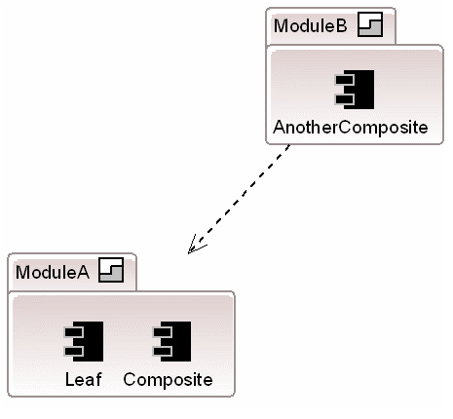
Finally: Modules
Modules provide a way to package up components
  These are the unit of deployment, not components!
  Indicate explicit dependencies on each other
Notes:
Modules as a unit of deployment resolve the conflict between making components small to make them reusable, and making them large to make them easily deployable.

Slide 23
How Does The Model Help Us?
The full model is very simple
  A component is a unit of instantiation
  Compose new components using connectors
  Package into modules and deploy
What do we get out of this hierarchical model?
  Chimes with an intuition about how to ”construct” software
  Use to assess other approaches
We can map this onto many technologies
  The core ideas remain the same
  We can add: distributed communications, different languages etc.
Notes:
The full model is very simple
A component is a unit of instantiation that specifies all services provided and required via interfaces
Compose new components by connecting together instances of other ones
What do we get out of this hierarchical model?
Chimes with an intuition about how to ”construct” software
A simple, but complete and we can use it to assess other models
Gives great insight into their limitations and strengths
Also gives insight into OO limitations and strengths
We can map this onto many technologies
The core ideas remain the same
We can add: distributed communications, different languages, analysis etc.

Slide 24
Differences from OO
It's OO with some intentional limitations!
A class can be a leaf component
  It must indicate all provided services via interfaces
  It must indicate all required interfaces
All component instantiation is via composites
  This is a big difference
  ”new”s must go from code into the configuration
  → Dependency Injection
Notes:
As we have seen, a class can be a leaf component
i.e. we can use an OO class as a component, with constraints
It must indicate all provided services via interfaces
(often done in OO)
It must indicate all require interfaces
(rarely done in OO consistently, but more common with DI)
All component instantiation is via composites
This is a big difference
Essentially, all ”new”s must go from code and are pushed into the configuration → a modern trend also in dependency injection
Makes the system architecture very explicit
No passing around of component references, all communication must be done via connectors

Slide 25
History of This Approach
Conic / Darwin from Imperial
  Inspiration behind Microsoft COM and others
ROOM from ObjectTime
  Model is now part of UML2 (complex story)
Most component models get it (often subtly) wrong...
Notes:
Most component models get it (often subtly) wrong...
Some don't allow multiple component instances
Or they allow composites with behaviour (e.g. UML2, Spring) or don't support composites at all (JavaBeans)
Or they don't provide connectors (COM, Spring, JavaBeans etc)
Or they use a registry for component instantiation (COM, EJB2, Eclipse), making models indirect and evolution tough (DLL hell!)...

Slide 26

Example: A Home Alarm System

Slide 27
A Simple Home Alarm System
Here is the class diagram
  Let's convert this into components!
Room
Intruder
Detector
(singleton)
ReallyLoud
Siren
Light
Sensor

Slide 28
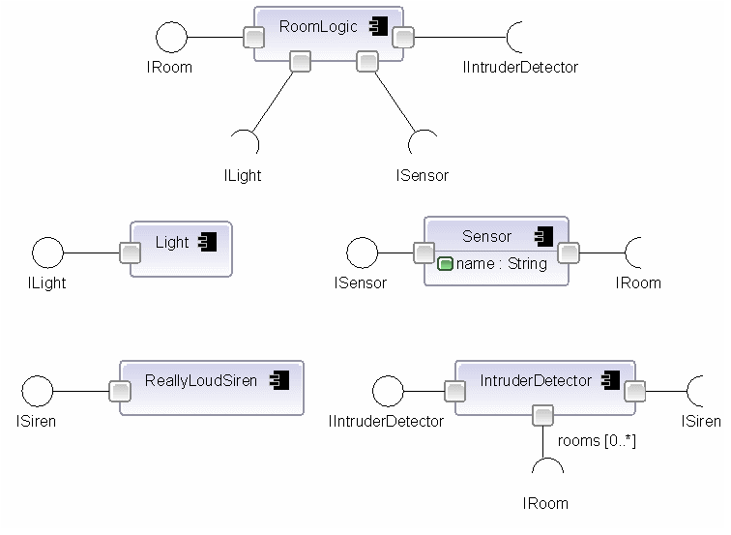
The Building Blocks

Slide 29
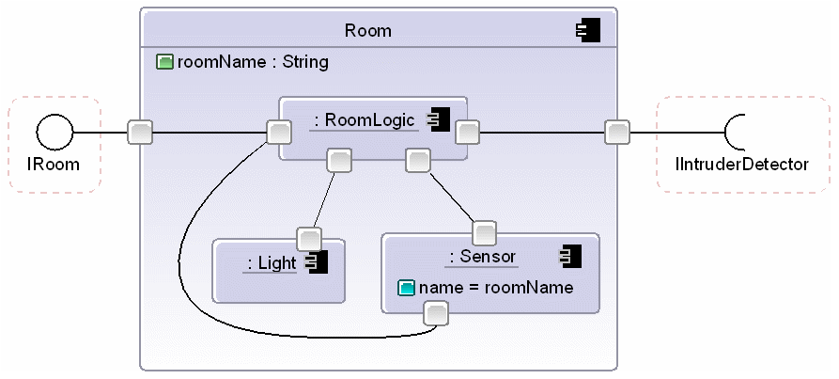
Let's Start Connecting Up!

Slide 30
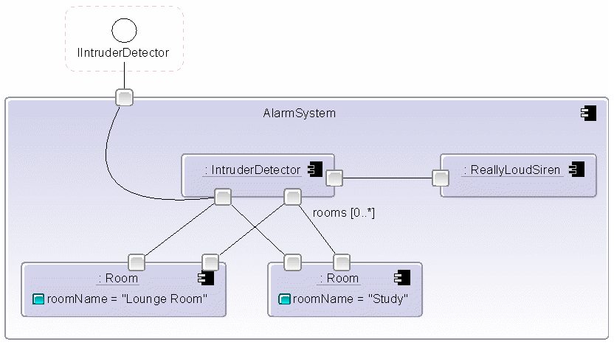
Connecting At A Higher Level

Slide 31
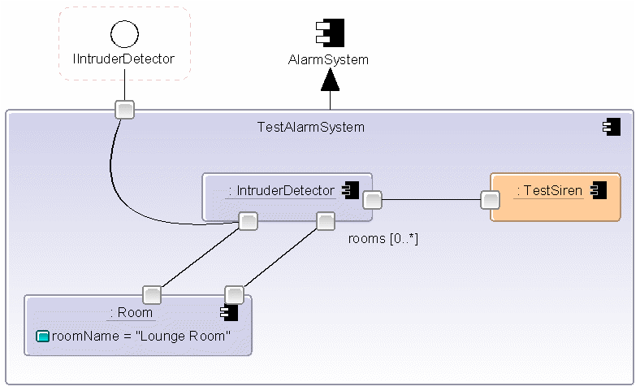
Switching In A Test Siren

Slide 32
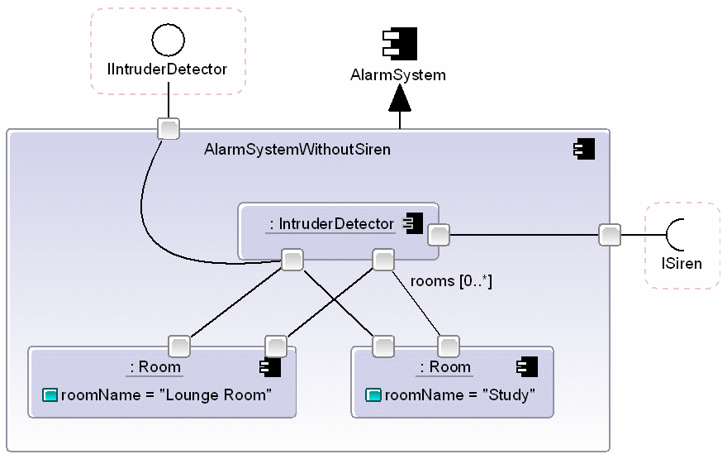
Alarm System Without Siren

Slide 33
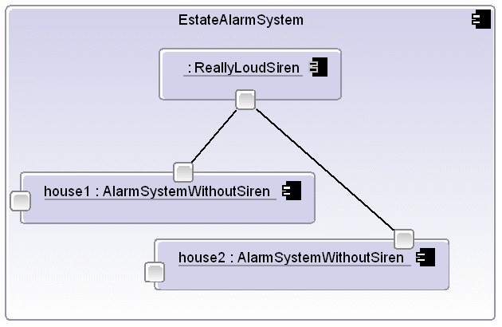
A Estate Alarm System

Slide 34
What Are We Achieving?
Creating a compositional hierarchy
EstateAlarmSystem
AlarmSystemWithoutSiren
ReallyLoudSiren
AlarmSystemWithoutSiren
IntruderDetector
Room
Room
Room
IntruderDetector
Room
Light
Sensor
RoomLogic
Light
Sensor
RoomLogic
Light
Sensor
RoomLogic
Light
Sensor
RoomLogic
Notes:
Creating composite structures
We are building higher level widgets without writing code
Without needing any special UI patterns or facilities
Connectors used for joining up widgets
Connectors also used for connecting event sources to sinks
Architecture is completely explicit

Slide 35
Summary: Our Component Model
Interface indicates a service contract
Component is a unit of assembly and instantiation...
  Wire together instances using connectors
Module is a unit of packaging & deployment
A simple and elegant model
    Can map onto many technologies
    We can use it to assess other models
Notes:
Interface indicates a service contract
Component is a unit of assembly
Can be ( multiply) instantiated inside another component
Explicit about all provided and required interfaces via ports
Allows a composition hierarchy
Composite components are simply wiring instructions
Leaf components must be ”implemented”
Dynamic architectural changes via components with lazily instantiated parts
Stratum / Module is a unit of deployment
Groups related definitions and selectively exports these
Possibly nested, with explicit dependencies on other strata

Slide 36
Tutorial
Wiring up objects...

Slide 37
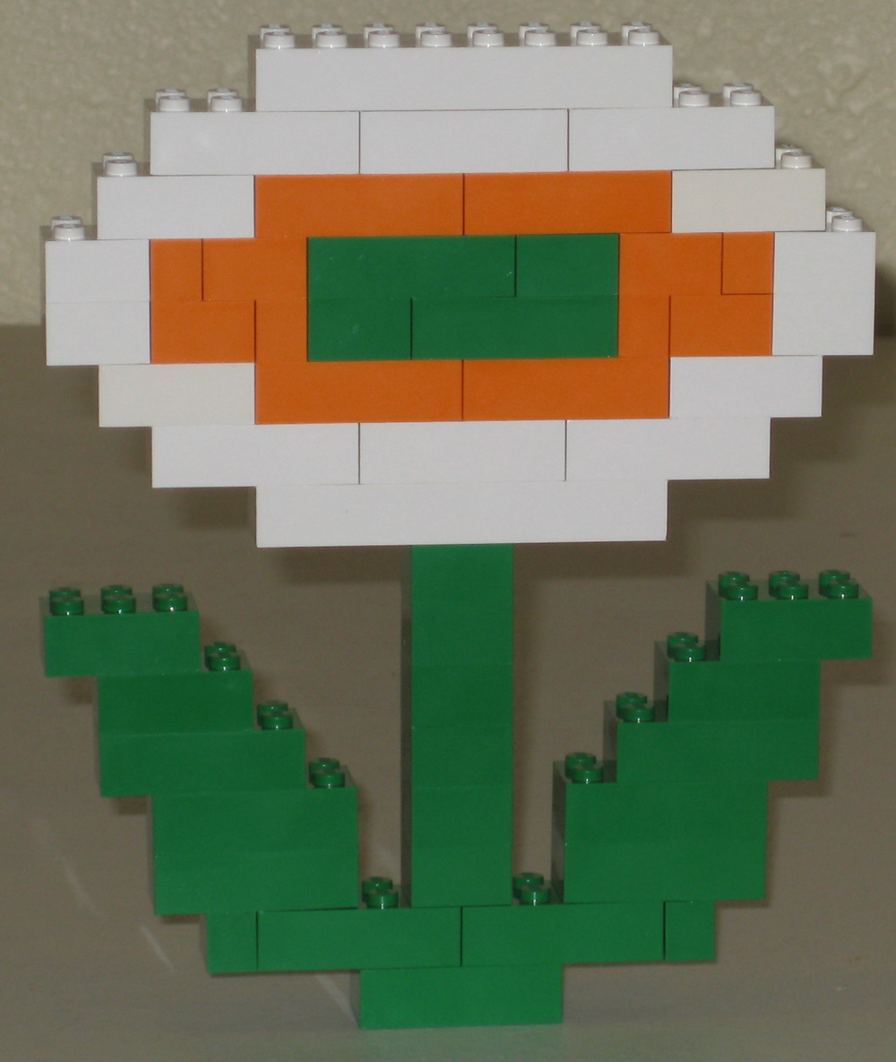
Part 2: Dependency Injection

Slide 38
What is DI?
Inject connections between objects rather than letting the objects set this up themselves...
  No ”new”s or connections deeply buried in code
  Push ”new” object allocation / connections up to highest level or
class A {
private B b = new B(); }
Hardcoded dependency
versus
class A {
private B b;
public A(B b) { this.b = b;}
}
and
new A(new B())
”Injected” dependency

Slide 39
Connections
E.g. For our home monitoring system, moving connections to highest level gives configurability
public static void main(String args[])
{
IntruderDetector detector = new IntruderDetector();
String roomName = "Lounge room";
Room room = new Room(detector, roomName, 3);
Sensor sensor = new Sensor(room, light);
room.setSensor(sensor);
Light light = new Light(roomName);
room.setLight(light);
sensor.setLight(light);
detector.addRoom(room);
...

Slide 40
Adjusting Connections is Cheaper...
public static void main(String args[])
{
IntruderDetector detector = new IntruderDetector();
String roomName = "Kitchen";
Room room = new Room(detector, roomName, 3);
Sensor sensor = new Sensor(room, light);
room.setSensor(sensor);
Light light = new TestLight(roomName);
room.setLight(light);
sensor.setLight(light);
detector.addRoom(room);
...

Slide 41
IoC Containers
A ”container” connects up & manages the lifecycle of objects
  connects instances via configuration & reflection
This is a common approach
  Spring (xml)
  Guice (java annotations)
  EMF (xml + attributes)
  Unity (xml + attributes)
Key point is that connections are no longer in code

Slide 42
DI initially was a reaction against EJB
EJB 2.X = Enterprise Java Beans
  Complex, popular Java enterprise system
  Very complex architectures
Difficult to unit test components
  They were hardwired to the service locator & container
  The locator was a big enterprise registry
  Components directly used J2EE services via JNDI locator
A rebellion ensued: the birth of Dependency Injection
http://martinfowler.com/articles/injection.html
Notes:
Difficult to convey how popular (and horrible) EJB2.x was...
EJB3.x is better – uses many DI concepts. Was a reaction against DI though...

Slide 43
Darwin History Lesson: Binding Types
First party binding
→ components use a registry = service locator
Give me a B
A
B
A
B
Third party binding
→ someone else makes the connection = DI
DI is simply a move from 1st to 3rd party binding!
Third party
A
B
Notes:
Interface indicates a service contract
Component is a unit of assembly
Can be ( multiply) instantiated inside another component
Explicit about all provided and required interfaces via ports
Allows a composition hierarchy
Composite components are simply wiring instructions
Leaf components must be ”implemented”
Dynamic architectural changes via components with lazily instantiated parts
Stratum / Module is a unit of deployment
Groups related definitions and selectively exports these
Possibly nested, with explicit dependencies on other strata

Slide 44
DI Started Simple...
Started as a way to instantiate & connect objects
  Allow OO principles in EJB
  Integration layer with Application Servers
  Allow full unit testing
  Unintrusive - ideally no coupling to the DI framework / container

Slide 45
Became a Wider Approach
Let's go a bit further... POJOs and PONOs
  Key idea is to keep core objects simple
  Use aspects & DI to avoid any coupling to enterprise services
  DI aims to keep the objects uncoupled to services
Aspects, injection of services
  Build simple domain objects
  Use AOP to layer on transactions, security, persistence
In some ways as complex/strange as what it replaced!
  Custom application servers
  Zealots

Slide 46
Birth of DI As A Force
Spring Framework

Slide 47
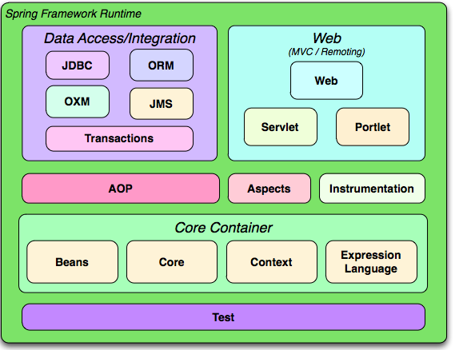
The Spring Framework
Widely used in enterprise Java
Core of Spring is a dependency injection framework
  Based on JavaBeans: wires up instances of beans
  Everything builds on this foundation: let's analyse it!

Slide 48
Wiring up JavaBeans Using XML
<beans>
<bean id="room" class="com.acme.homemonitoring.Room">
<constructor-arg>
<ref bean=”sensor”/>
<ref bean=”light”/>
<value>Lounge Room</value>
</constructor-arg>
</bean>
...
<bean id="sensor" class="com.acme.homemonitoring.Sensor">
<property name=”room” ref=”room”/>
<property name=”light” ref=”light”/>
</bean>
<bean id="light" class="com.acme.homemonitoring.Light"/>
…
</beans>
A bean
can refer to others...
(sort of composite)
Or no references
(a leaf)

Slide 49
What Is This Doing?
<bean id="room" class="com.acme.homemonitoring.Room">
<constructor-arg>
<ref bean=”sensor”/>
<ref bean=”light”/>
<value>Lounge Room</value>
</constructor-arg>
</bean>
Room (bean)
Sensor (bean)
Light (bean)

Slide 50
Singletons versus Prototypes
Beans are singleton by default
  A reference to a singleton provides the same object each time
  So bidirectional connections only work b/w singletons
Or we can mark a bean as prototype
  Each reference creates a newly created object
Umm, what if we want 2 rooms configured?!
Room1 (bean)
Room2 (bean)
Sensor (bean)
Light (bean)
Sensor (bean)
Light (bean)

Slide 51
Configuring Complex Structures?
If we use prototype we can have
only tree connections
  Singletons allow complex connections
  but you can only have 1
  Instead of fixing the singleton pattern,
  they've made it as bad
  but in a more subtle way...
Doesn't handle complex interconnections
  No real connectors, just references
  Causes a conflict between singleton and prototype
  Confuses instances (beans) and component definitions (beans!)
  They've got the model subtly wrong
  Look into FactoryBeans for some relief...

Slide 52
Aspects
An aspect modularises a cross-cutting concern
  i.e. Keeps it in 1 place
    Security checks
    Exception handling
    Transactions
    Logging etc.
Classes for our system
Classes for our login screen
(aspects)

Slide 53
Aspects (2)
Spring aspects turn into proxies (usually)
Room (bean)
Security
logic
Sensor (bean)
Light (bean)

Slide 54
Aspects (3)
Allows us to do this
Security, persistence to dbs,
Logging, transactions, some logic
Plain objects, no coupling to enterpise services
= easy to create, easy to test!

Slide 55
Limitations of Aspects
Limitations
  Aspects are a secondary axis = less powerful
  Aspects can't refer to other aspects
  Quantification is problematic (e.g. All methods like ”set*()”)
  Interaction with business logic difficult
  Indirect = complex architectures

Slide 56
Summary of Spring
JavaBeans is a decent, if simple, component base
  Spring can wire up simple tree instances ok
  Beyond this we use singletons or find workarounds
    Or limit our architectures?!
Problems come from lack of ”full” component model
  No explicit instances or connectors
  Composite beans always refer to an implementation class...
  Confuses components and instances
A very useful approach, but built on a weak base

Slide 57

Connections Move Back into Code!

Slide 58
Code → XML
Why did we move new()s and connections into XML?
  To allow us to vary connections
  To prevent coupling to databases / enterprise services
What are the negatives?
  Complex separation of code and config
  Config may fail at runtime only
  Difficult to refactor

Slide 59
Moving Connections Back!
Guice uses Java annotations
  Metadata indicates possible connections
  Not part of the class logic → testing stays easy
  Doesn't hardcode connections → structure can vary
public class Client
{
private IService service;
@Inject
public Client(IService service) { this.service = service; }
}
@ImplementedBy(ServiceImpl.class)
public interface IService {}
@Singleton
public class ServiceImpl implements Iservice
{...}

Slide 60
Moving Connections Back (2)!
Uses modules to control or override config
public class MyModule implements Module
{
public void configure(Binder binder)
{
// could be class / prototype based
binder.bind(IService.class).to(ServiceImpl.class);
// or alternatively can use a singleton
binder.bind(IService.class).to(
new ServiceImpl());
...
}
}

Slide 61
Config is Now Code...
So, when we refactor... it works
public class Client
{
private IService service;
@Inject
public Client(IService service) { this.service = service; }
}
@ImplementedBy(AmazingService.class)
public interface IService {}
@Singleton
public class AmazingService implements Iservice
{...}
And the IDE
adjusted this!
We refactored this

Slide 62
Guice Providers
Providers allow for more complex connections
  Without binding directly to an implementation
Is it as expressive as a full connection model?
  Not sure... It is powerful, but I have concerns...
  Architecture isn't explicit → connections in code again!!!
public class Room
{
@Inject
public void injectLight(Provider<Light> provider)
{
Light light = provider.get();
sensor.setLight(light);
}

Slide 63
Aspects in Guice
An interceptor approach
  Method level proxies rather than class level
  Simple and limited, but still powerful
  In code, so can also refactor!
binder.bindInterceptor(
any(), // match classes
annotatedWith(Transactional.class), // match methods
new TransactionInterceptor()); // use this to intervene

Slide 64
Summary of Guice
Powerful DI approach
  Heavily used inside Google → battle tested via Adwords etc.
  Code based for greater configuration control
  Has aspects, scopes, etc → full DI facilities
Guice versus Spring
  Much less integration with JEE stack (JDBC, JMS etc)
  Easier to configure
    But Spring introduced annotations shortly after...
  Guice is just DI
    Spring often used as app config also
  Config in code means any config change = code change
  Connection model is more powerful
  Far simpler, less baggage

Slide 65
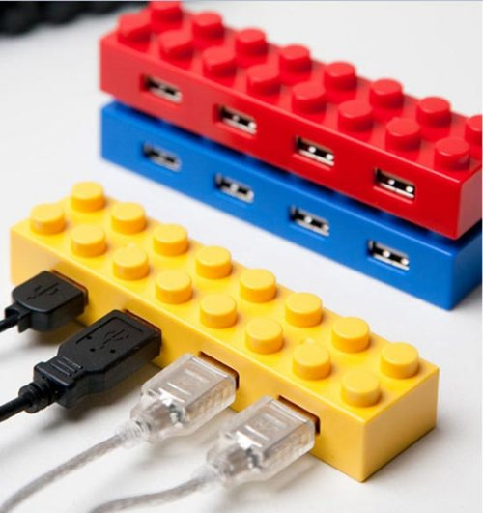
Extensibility via Components:
.Net Managed Extensibility Framework

Slide 66
MEF from Microsoft
From MEF website
  ”simplifies creation of extensible applications”
  ”provides a standard way for an application to expose itself and consume external extension”
  ”offers a set of discovery approaches... to locate and load available extensions”
Use case: extensible GUI app
plugin1
plugin2
pluginN
Base application

Slide 67
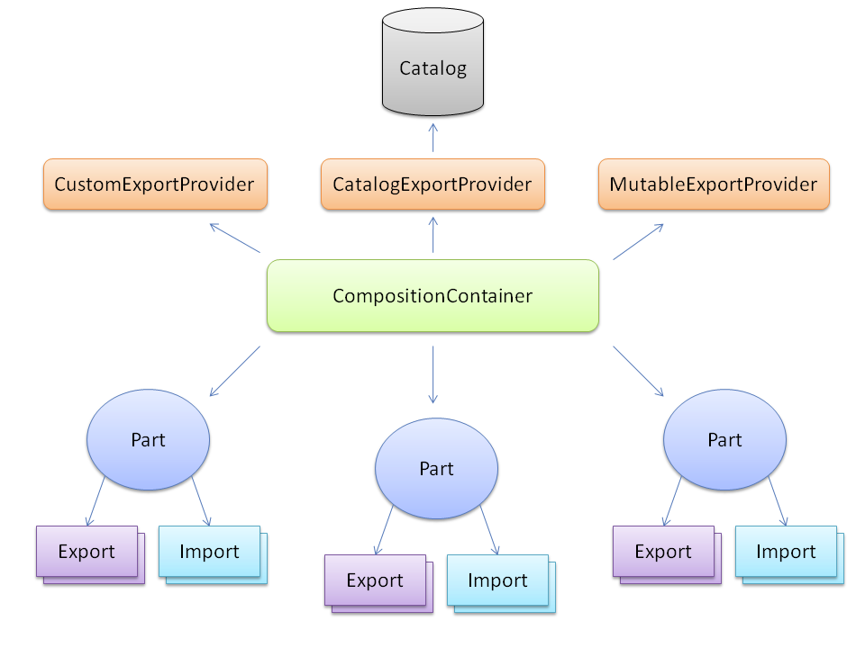
MEF Architecture

Slide 68
MEF Parts
A DLL that declares exported and imported things
  In other words, a dynamically loaded module!
[Export(typeof(IMessageSender))]
public class EmailSender : IMessageSender {
...
}
[PartCreationPolicy(CreationPolicy.NonShared)]
[Export(typeof(IMessageSender))]
public class TCPSender : IMessageSender {
...
}
public class Notifier {
[ImportMany]
public IEnumerable<IMessageSender> Senders {get; set;}
public void Notify(string message) {
foreach(IMessageSender sender in Senders)
sender.Send(message);
}
}
I provide this
Singleton!
I require this

Slide 69
Using the MEF Container
Container creates and connects the parts
  Also controls their lifecycle
public class Program
{
public static void Main(string[] args)
{
Program p = new Program();
p.Run();
}
public void Run()
{
Compose();
}
private void Compose()
{
var container = new CompositionContainer();
container.ComposeParts(this);
}
}
Starts up container

Slide 70
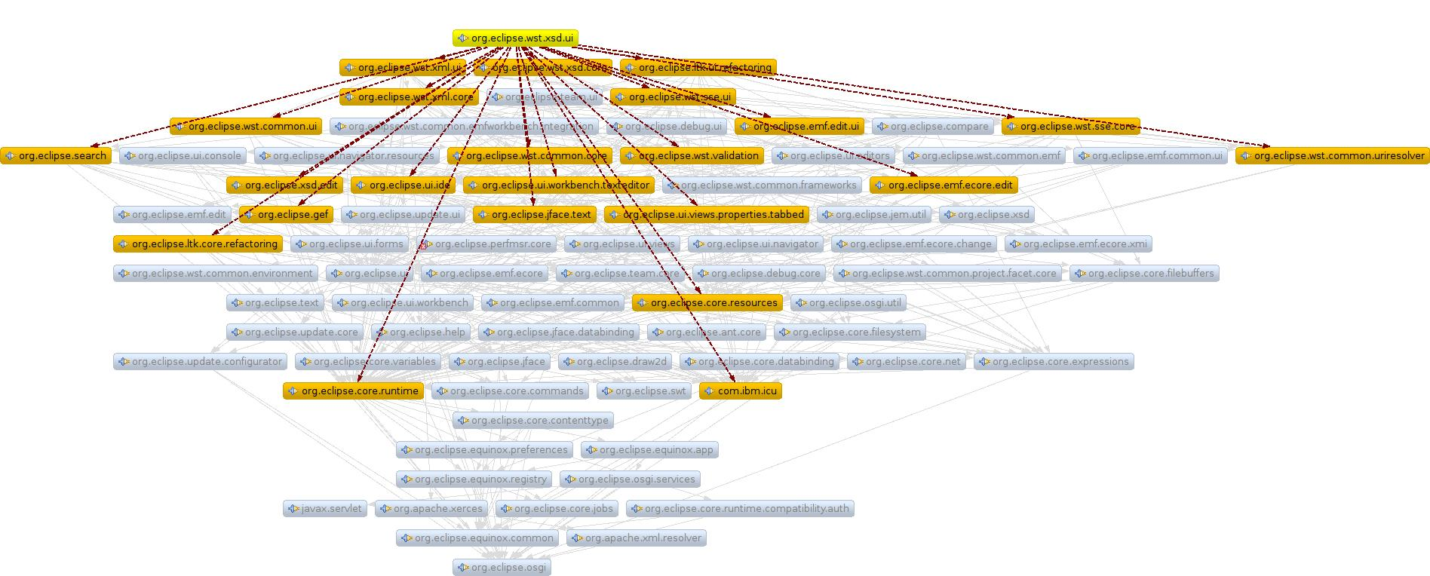
A Bit Like Eclipse...
Parts are plugins
  A complex Eclipse installation will have 500+ plugins
  Difficult to understand the architecture by looking at the plugin dependencies

Slide 71
Summary of MEF
Basically a DI container → similar to Guice / Eclipse
  Attributes (annotations) used heavily
  Particularly focussed on runtime discovery and loading
Parts are like modules
  (except they call them components!)
  Export and import
  Nice extensibility mechanism
Classes are treated like components
Same connector limitations as DI

Slide 72
Summary

Slide 73
Summary of Lecture
Components as an idea keep coming back
  Building via reusable blocks is too compelling
  Separation from environment works well for unit testing and extensibility / evolution
The full hierarchical model is powerful
  Connectors, components, parts, composites and modules
Most approaches get it (subtly) wrong
  But we still get some benefits of components → DI
What do we lose by not following this model?
  Ability to analyse architecture separate from code
  Ability to have full architecture outside of code

Slide 74
Resources
Spring
  http://www.springsource.org/ + ”Pro Spring” book
Guice
  http://code.google.com/p/google-guice/
  + user guide for v1.0: http://jquery.malsup.com/media/guice.pdf
Managed Extensibility Framework
  http://mef.codeplex.com/
Darwin
  Good overview of structure & analysis side
  http://www.sti.uniurb.it/events/sfm03sa/slides/jeff_jeff.pdf
Component tool for my phd
  www.intrinsarc.com
  DI versus components http://www.javalobby.org/articles/di-heritage/

